Slide 1

North Carolina Area 51
General Service Representative
Overview
I’m a GSR
now what?
Notes:
Welcome.

Slide 2
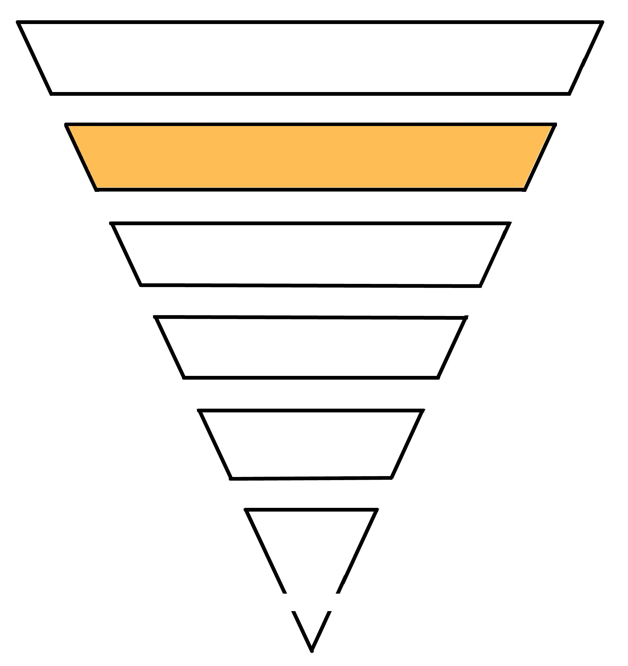
Structure of the Conference
(U.S. and Canada)
A.A. Groups
Group GSRs
Districts
Area Assemblies
Delegates to the General
Service Conference
Remember,
you are the link between your group and your district.
General
Service
Board
A.A. World Services
A.A. Grapevine
Notes:
If you're new to general service, going through a training like this can be helpful. You may also want to get a service sponsor which would be a more experienced person as a GSR, an alternate DCM, DCM, or even area officer that can help guide you through the process. If you're experienced or coming back, hopefully you'll find some things in this presentation that will help you. Many of us have seen the upside down triangle which describes how AA works. It is very different than a corporation where a president or CEO tells everyone else what to do. In this case, AA members make up AA groups. They bring concerns to their GSRs and the GSRs bring those concerns to the district or the area. The district and area may also have issues that they need votes on, and the GSR goes back to the group to get an informed group conscience. So the GSR provides a link to AA members that sit in the groups and their district and area. That's why it's so important for a GSR to attend their district meetings and also their area assemblies at the area assembly. A delegate will actually bring those opinions to the General Service Conference once a year in New York City.

Slide 3

General duties
of a general service representative
Passing their
group’s conscience
to their DCM at
District Meetings
and to their
Delegate at Area
Assemblies
Registering
with GSO
as the GSR
for your
group
Linking their
group to
AA as a whole
Acting as
the voice
of their
group’s
conscience
Bringing
suggestions
from the area
and district
back to their
group
Notes:
A GSR does a number of things. They generally provide a link to their group, to AA as a whole, through the district meetings and area assemblies. They may act as the voice of their group. If they have issues, they may bring those to the district or even to the area and communicate them. They also listen at the district meeting and the area assemblies for any policies or motions that they need to bring back to their group and get a vote on. They also register their information with general service in New York City and with their area so that they can receive communication from those different places and be identified as a link to their group.

Slide 4
Three Areas of Responsibility
for a general service representative
A general service representative has a two-way relationship:
  Group Conscience
  Reports
  12 Traditions
Area Assemblies
District Meeting
Area
District
Group
  Reports
  12 Traditions
  Group Conscience
District Meeting
Area Assemblies
Group
District
Area
Notes:
So a general service representative has a two way relationship with their group. They provide a report to the group of what's happening in the district and what's going on at the area assemblies. They also help uphold the twelve traditions, as any officer of the group would do. They also assist the group in holding a group conscience with either things that are brought back from the district or area or things that are growing out of their group. And at the district they would give a report of what's happening at their group and at their area assembly. They provide a short report as well as to what's going on with their group.

Slide 5
WHAT do I report?
SAMPLE GSR Area Assembly Report:
Election results: Veronica M as Delegate, Jennifer P. as Chair, etc.)
Overview of treasurer report. Area has a surplus and needs ideas from Groups and Districts on how to spend. Email treasurer with ideas.
Pre-conferences will be held in March and April. The Central precon will be hosted by District 18 on March 15th. There will be a Zoom option as well.
Grapevine has a new podcast and is developing a new app.
Next Assembly will be held June 16-17 in Raleigh. Group will need to approve covering the expenses for GSR to attend.
SAMPLE GSR District Meeting Report:
Tom D elected as DCM
Group contributions are down
Treasury had $400 in income and $300 in expenses
District Alcothon will be held December 31st and needs volunteers .Email DCM to sign up.
Prison meeting started back up
TFC is taking meetings into Memorial Hospital and needs groups to cover slots.
Please note that these are
just samples; your reports may be very different.
At your homegroup business meeting, a district report may look something like this
At your homegroup business meeting, an Area Assembly report may look something like this
Notes:
I wanted to show you what a sample report is. I used to be a GSR for a very large meeting, a group in my area. And basically when I would report to my district, I often would report on things like elections, treasury, any sort of concerns about how groups are doing or how meetings are doing, any sort of changes in how we run our meetings. And of course, when our next group conscious is. When I went to the area assemblies, it would be important that I give some of the same information, but it also has a little bit changed. My GSR report form indicates things like the following important things have occurred. We face these challenges, which is more information about what things we were trying to deal with at our group. We carried the message by doing what? What are our current goals, other things we wanted to share, which could also include events. So the report that I would give at the area could be actually written report that would be sent to the area registrar so that that could be included in minutes. At my district, I might give that report verbally and I would also give it in written form to my district Google Drive. Your district may not have a Google Drive or may not want it in writing. So there's actually two different reports given on somewhat the same information at the district and the area level. That's why it's so important that I attended both of those things.

Slide 6
Who’s does what
at an AA group:
 | General Service Representative | Intergroup Representative | Meeting or Group Chairperson
Registers group (and GSR) with GSO.
Helps group adhere to 12 traditions.
Helps treasurer develop 7th tradition contribution plan.
Gives group report at district meetings and area assemblies.
Brings back issues from district and area for group to vote on.
Helps group achieve informed group conscience.
Reports back to district and area.
Shares GSO information, including Box 4-5-9, with group.
Is familiar with AA’s 12 concepts and additional literature.
Notes:
As you're looking at what a general service representative does, there is a little bit of overlap between an intergroup representative or a group chairperson. You can review these on your own, but basically a GSR is more comprehensive in trying to carry the information from the group or an informed group conscience back to the district and to the area. And as a person becomes more experienced as a GSR, he or she understands the traditions better and also the twelve concepts.

Slide 7
How to help your group get an
informed group conscience
STEP 01
STEP 03
STEP 05
Gather
knowledge
Members
share
Recap / minority
opinion
Informed
Group
Conscience
STEP 02
STEP 04
Present topic
or issue
Consensus
(2/3rds)
There are two ways to take a group conscience—the competitive way permits the person with the loudest voice to push his or her ideas across, take a vote. This is not an informed group conscience. In the cooperative way, group members come together in mutual trust to arrive at a group decision—not one individual’s personal triumph.
Notes:
Every year there is a group of issues that is given out by the delegate, and that's through the General Service Conference and the GSR should choose some of those issues and bring it back to their group and get a group conscience on things like do we want a fifth edition of the Big Book? Or gosh, should we have a fourth edition of the Big Book in Spanish? Or does AA want to create a more easy to read version of the Big Book that might be a fourth or fifth grade reading level? Those were some of the ones that came up this current year. And that GSR would take those issues back to the group, they would gather information, background on those General Service report items and actually try to make it manageable for the group and have several informed group consciences where they present the topic in a short way. Members share about what they like or don't like about it, that they call for a vote. They attempt to get a two thirds consensus, and for the person who the vote didn't go their way, they would be asked for a minority opinion, and they would carry that informed group conscience on each issue back to their area assembly. There are also other things that an area or a district might want a group conscience on. So, this process is the same whether it's for an issue that's going to go to New York City or something local.

Slide 8
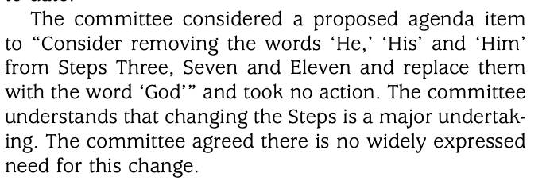
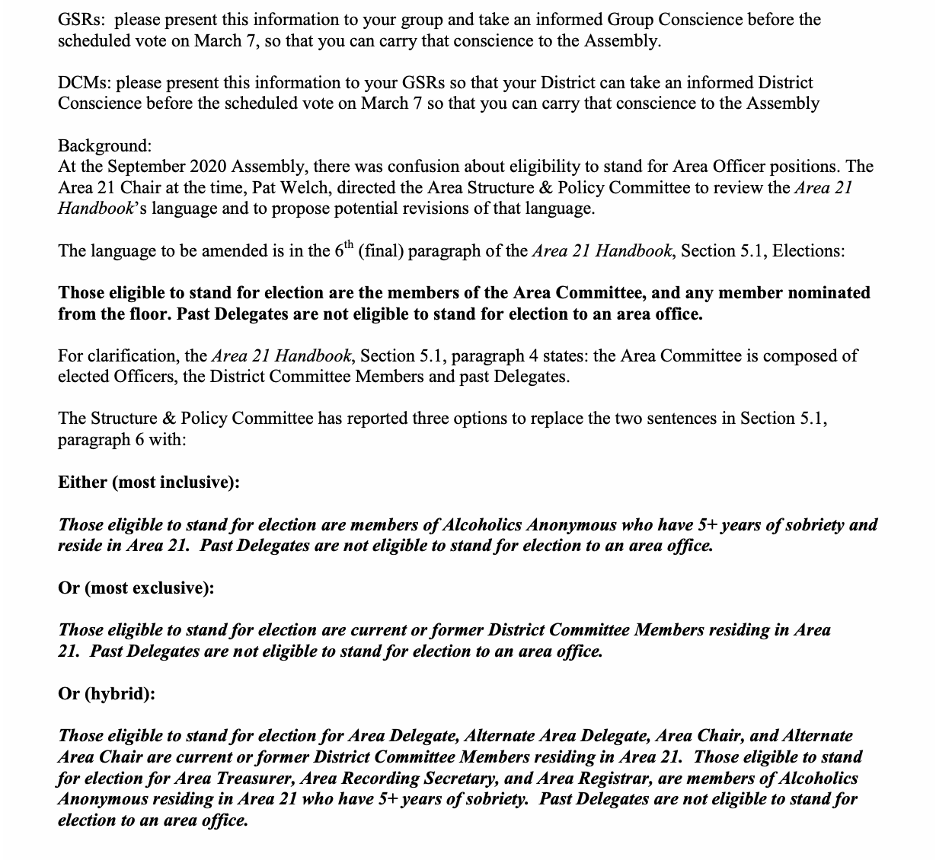
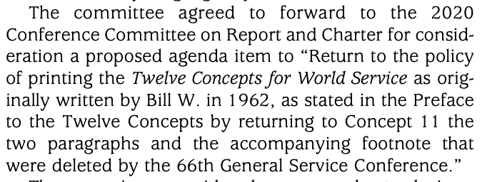
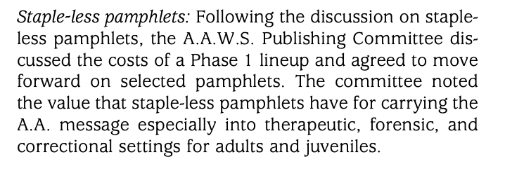
What do I bring to my group for an
informed group conscience?
Please note that these are examples; topics will vary.
An issue that needs a group conscience which impacts Area 51 may look like this
An issue that needs a group conscience which impacts GSO may look like this
Notes:
I wanted to show an example of kind of a current one that came up last year and this was actually for my area to decide who got to do which jobs and what would be the history or background of that person to be able to stand for that position. And so with that, our area chair made a very easy handout. I made copies for my group. I set up a group conscience at my group. They would have one every month, so it wasn't hard to arrange one. I would make that literature available, I would read the bolded parts, ask for questions, inform the group as well as I could what I knew about it, and then ask for a vote. In this case, I was hoping for a two thirds vote so I could bring that informed group conscience back to my area assembly. On the right hand side, I wanted to give some kind of historic stuff. When you see a General Service Conference, it's almost like an annual report. You'll actually see things like this where AA members go to their group, their GSR then takes their opinion to the district into the area, and these are some of the things that came out of it. So know that every AA member who is represented by a GSR or an alternate GSR has an opinion as to what goes on in Alcoholic Synonymous. Those annual reports are available and they're actually quite fascinating to read.

Slide 9
Where do the 12 concepts fit?
Here’s how some A.A. members become of service to A.A. as a whole:
12 Concepts
12 Traditions
12 Steps
A.A. ’s Twelve Steps are a group of principles, spiritual in their nature, which, if practiced as a way of life, can expel the obsession to drink and enable the sufferer to become happily and usefully whole.
(From the foreward of A.A.’s Twelve Steps and Twelve Traditions.)
A.A. ’s Twelve Traditions apply to the life of the Fellowship itself. They outline the means by which A.A. maintains its unity and relates itself to the world about it, the way it lives and grows.
(From the foreward of A.A.’s Twelve Steps and Twelve Traditions.)
The Twelve Concepts for World Service were written by A.A.’s co-founder Bill W., and were adopted by the General Service Conference of Alcoholics Anonymous in 1962. The Concepts are an interpretation of A.A.’s world service structure as it emerged through A.A.’s early history and experience.
(From The Twelve Concepts for World Service, Copyright 1982.)
Notes:
When people get into AA, often the Twelve Steps is the most important part of the program for them. It helps them stay sober as an individual. There's more information here about that and of course your sponsor will help you through the steps. The Twelve Traditions become more important as a person starts doing service and they see how groups work and they want the group to run smoothly and they want AA to last as a whole for all time. So, traditions are great as well. Most people who are in AA for any time work the Twelve Steps with their sponsor. They often work the Twelve Traditions with their sponsor. The twelve concepts are even more advanced. They are basically written by Bill W and others and they were presented at the General Service Conference in 1962. These concepts help shape the service across nationally and internationally, so that AA is always going to be here forever and ever for anybody who wants it. It helps people stay sort of right sized. For most people, they would work the Twelve Steps and Twelve Traditions with their sponsor. The Twelve Concepts is something they might work with their sponsor or with something called A Service sponsor. When a person has been in service, either at intergroup or general service or some other form, they will find somebody who's more experienced. Possibly another GSR, an alternate DCM, a DCM or an officer of the area that will help guide them through those concepts so that when they are at area assemblies or even at their own district meetings, they're providing information in such a way that upholds the traditions and keeps AA running smoothly.

Slide 10


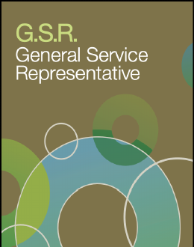
Literature
to help you get oriented
Ask your GSR Workshop Committee Chair to mail you these pamphlets—or find them online:
https://www.aa.org/assets/en_US/p-19_gsr.pdf
https://www.aa.org/assets/en_US/p-18_InsideAA.pdf
https://www.aa.org/assets/en_us/p-16_theaagroup.pdf
Notes:
There's lots of really good literature. I agree with those who believe that the AA Group is the best pamphlet of all. It's quite a chunky little pamphlet that you can get from your intergroup office. You can also go to one of these websites and just download these and read them. GSR is a great pamphlet for folks who are new to General Service or want to brush up on what exactly is my job?

Slide 11
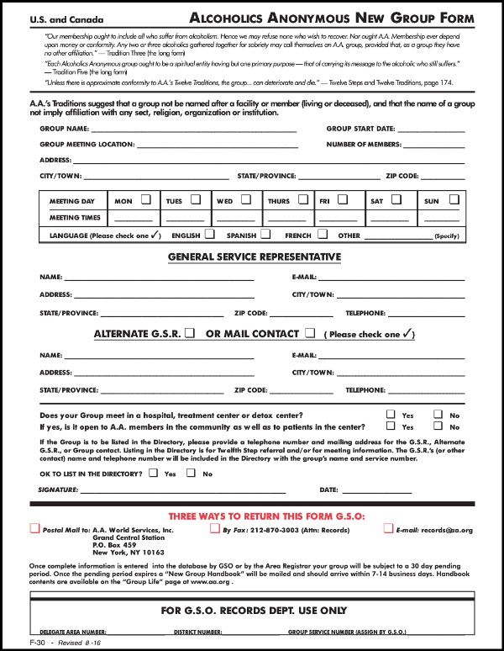
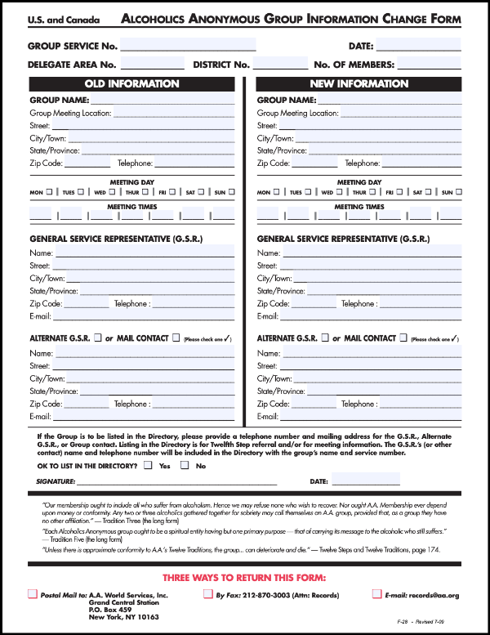
Forms
for general service representatives
Your DCM can help you fill
these out. Please email your form
to registrarsia21@gmail.com
and to records@aa.org
Use the
NEW GROUP
form to report
a new AA group that’s forming
Use the CHANGE form to report
that you’re replacing another GSR (or
that you’re the
new GSR).
Ask your GSR Workshop Committee Chair to mail you these forms—or find them online:
https://www.aa.org/assets/en_US/e_infchan.pdf
https://www.aa.org/assets/en_US/e_group.pdf
Notes:
There are several forms that are extremely important as a General Service representative that you need to be familiar with if you're representing a new group. For example, on the right hand side, you would fill out the new group form. So you may have to work with your chairperson to decide, okay, how long is the group in meeting? What is our location, do we meet Mondays, Thursdays? What are our meeting times? You may only have their personal name or their email. You may not have anything else, and that's okay. On the right hand side, you'll provide your personal information. This is held only for AA officers to see, so please don't be worried that this will be published. In fact, there's a little box that you can check that says okay to list in the directory. Please check no. Unless you are in a very distant region where there is no inner group or district and you want to be a phone contact for people who want to get a hold of Alcoholics Anonymous. Most people will check no there for the other information your group often has published where they meet, how many times they meet, and you can fill it out as well as you can. Your alternate GCM or DCM can help you fill that out and get it to records@aa.org or to the registrar. I've also included some links here in case you want to simply click on them and fill them out and email them in yourself. We have a relationship with our registrar where the DCM can directly e-mail these forms to our registrar and they will automatically input them for us.

Slide 12
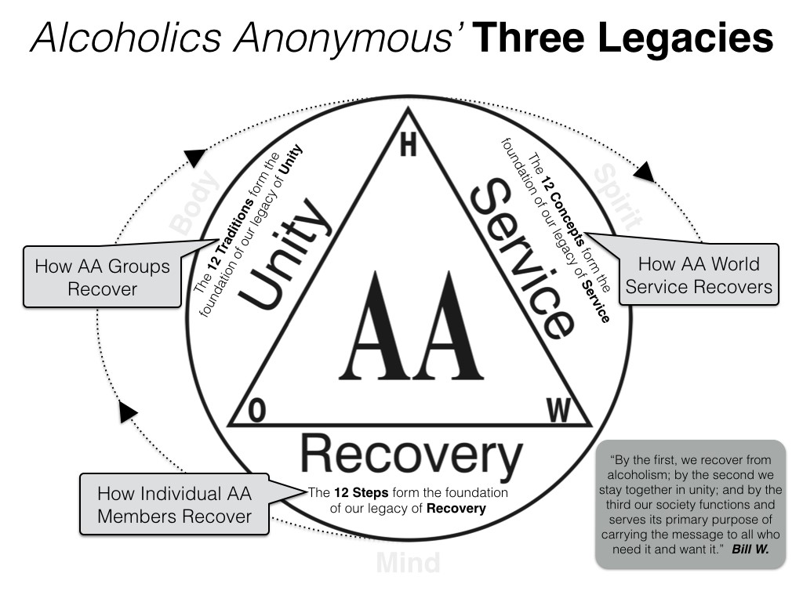
Notes:
I like this slide.

Slide 13
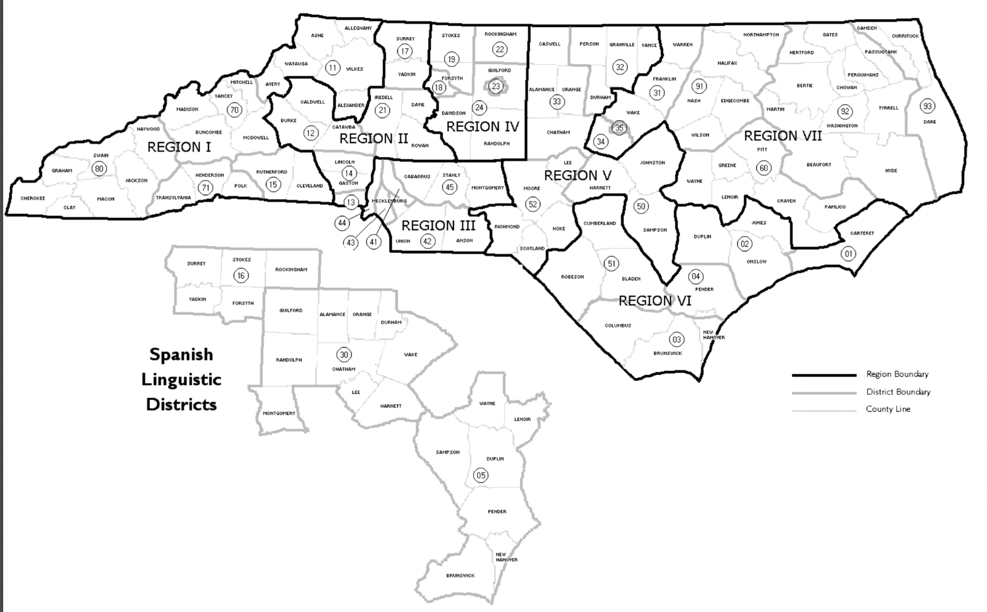
District Map of Area 51 NC
This map represents a general outline of districts.
Area: A geographical division within a state or province. A Delegate to the General Service Conference is elected from an area assembly. Normally, there is one area to a state or province except in heavily A.A.-populated places where there may be 2, 3, or more areas in a state or province. Some areas include portions of more than one state or province. There are 93 Areas in the U.S.
North Carolina is comprised of 1 area: Area 51
District: A division within the area represented by GSRs and District Committee Members.
NC Area 51 is broken down by 3 geographical sections and the Spanish Language Districts
North Carolina Area 51 has 40 districts.
Western | 11, 12, 13, 14, 15, 17, 21, 41, 43, 44, 70, 71, 80
Central | 18, 19, 22, 23, 24, 30, 32, 33, 42, 45, 51, 52
Eastern | 01, 02, 03, 04, 31, 34, 35, 50, 60, 91, 92, 93
Spanish | 05, 16, 30
Notes:
I like this slide.

Slide 14
AA’s Declaration of Unity:
This we owe to A.A.’s future; to place our common welfare first; to keep our fellowship united. For on A.A. unity depends our lives and the lives of those to come.
Did you know that
the general service representative position was created in 1954 during the General Service Conference?
The GSR Preamble:
We are the General Service Representatives. We are the link in the
chain of communication for our groups with the General Service Conference
and the world of A.A. We realize the ultimate authority is a loving God as he may express Himself in our Group Conscience. As trusted servants, our job is to bring information to our groups in order that they can reach an informed group conscience. In passing along this group conscience, we are helping to maintain the unity and strength so vital to our fellowship. Let us, therefore, have the patience and tolerance to listen while others share, the courage to speak up when we have something to share, and the wisdom to do what is right for our group and A.A. as a whole.

Slide 15

!
?
?
Time to ask questions

